Slide 1
London
Battle of neighborhoods

Slide 2
Introduction
The Business problem
A Greek company is interested in investing in a Greek restaurant somewhere in London.
Our purpose
Find the optimal place in London to build a Greek restaurant.
Tools
Machine Learning, Statistical analytics & Business KPIs
Business Strategy / Criteria
Less competition, close to central London, other venues nearby except anything related to food venues
Moving forward in 3 steps
Find the Area of London with the least number of restaurants
Choose the best Group of neighborhoods in the selected area
Select the optimal neighborhood from the chosen cluster

Slide 3
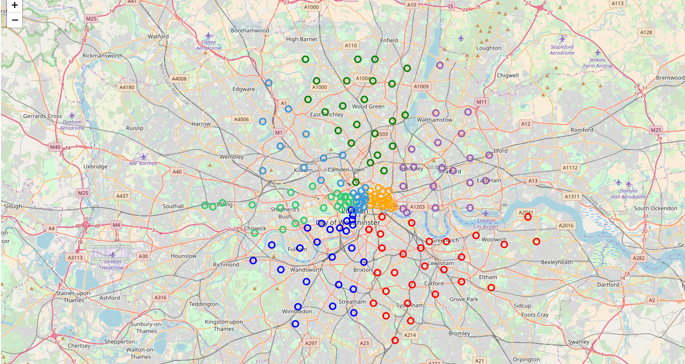
Data
Data Gathering
Text mining from 8 sources (wikipedia)
Cleansing
London Data Frame
PostCode(e.g. N1C)
Neighborhood(e.g. Kings Cross Central)
Area(e.g. Camden)
Area category(e.g.North)
Latitude & Longitude
Foursquare Location Data
Create Dummies for each venue categories
Extract venues information for each area & neighborhood

Slide 4
Methodology
Data analysis to find the best area & neighborhood to build our restaurant.
Aggregations & Frequency distribution analysis to determine the Area Category with the smaller presence of restaurants (took into consideration the top 20 most common venues nearby).
For the chosen area, we proceeded in aggregations and frequency tables for each neighborhood.
K-means Clustering to group the neighborhoods into 5 clusters based on venues nearby.
Geospatial view of grouped neighborhoods.
Exploration of each cluster's characteristics & choose the cluster with the least food venues nearby.
Geospatial analysis to determine the neighborhood that fulfills the criteria of minimum distance from central London and simultaneously strong presence of other type of venues nearby(e.g. entertainment venues).

Slide 5
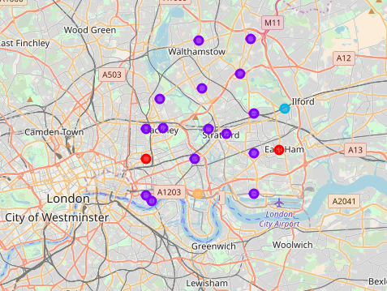
REsults
Selected Area: East London
In order to decide which area of London is the best, we took into consideration the top 20 most common venues from Foursquare. We selected the area with the least percentage of restaurants and other types of food industry.
Selected Group of Neighborhoods: 2nd Cluster
For East London, we took into consideration the top 10 most common venues for each neighborhood and we grouped our neighborhoods into 5 clusters based on the venues nearby. We selected our cluster based on the smaller number of food venues nearby.
Selected Neighborhood: PostCode E1W
District/Area: Tower Hamlets
Neighborhoods: Wapping, St Katharine Docks, Stepney, Shadwell, Whitechapel
From 2nd cluster E1W & E1 where the neighborhoods closest to central London. Chose E1W due to less competition nearby and existance of other entertainment venues nearby(e.g. park) that macthup with a good lunch or dinner.

Slide 6
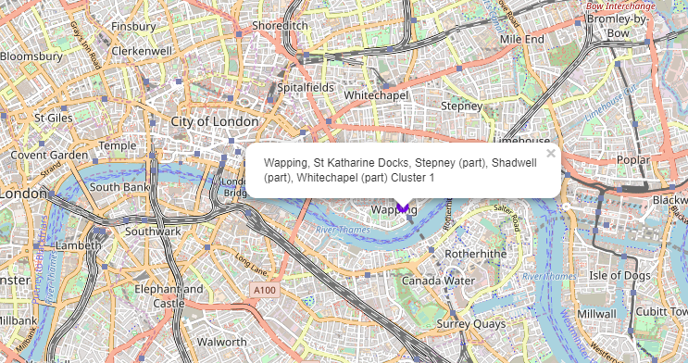
KeyPoints / Proposal
Summary
Checked 178 London Neighborhoods
Selected East London – 20 Neighborhoods
Selected neighborhood with Postal Code E1W
Decision Factors
Less Competition nearby
Distance from Central London
Other entertainment venues nearby
Proposal
Postal Code: E1W - East London
Area: Tower Hamlets
Neighborhoods: Wapping, St Katharine Docks, Stepney, Shadwell, Whitechapel
Comments: there are only two restaurants (Italian & Indian). Additionally, it is really close to central London and nearby you will find a park,a pub,a coffee shop etc.
είμενο
Κάντε κλικ για να προσθέσετε κείμενο

Slide 7
Thank you

